Slide 1
“THE RED/GREEN AXIS: From
Antonio Gramsci to BLM & Antifa,
The Insurgency Being Waged
Against America”

Slide 2
MAJOR TAKE-AWAYS;
Identify the Major Historical Figures Who Started the Insurgency Against America;
Examine How the Muslim Brotherhood Promotes Social Unrest in America;
Disclose the Stated Objectives of the Black Lives Matter (BLM) Movement; and
Unveil the Link of ANTIFA to Jihadist Groups in the Middle-East.

Slide 3
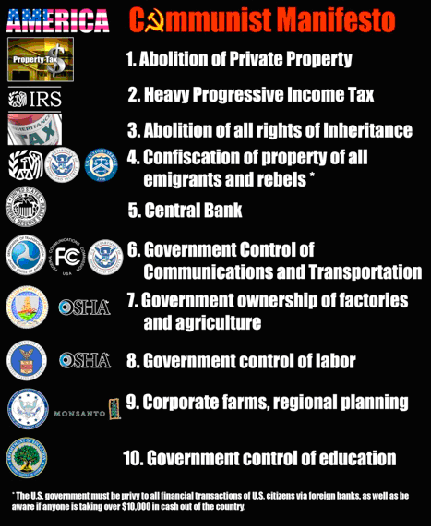
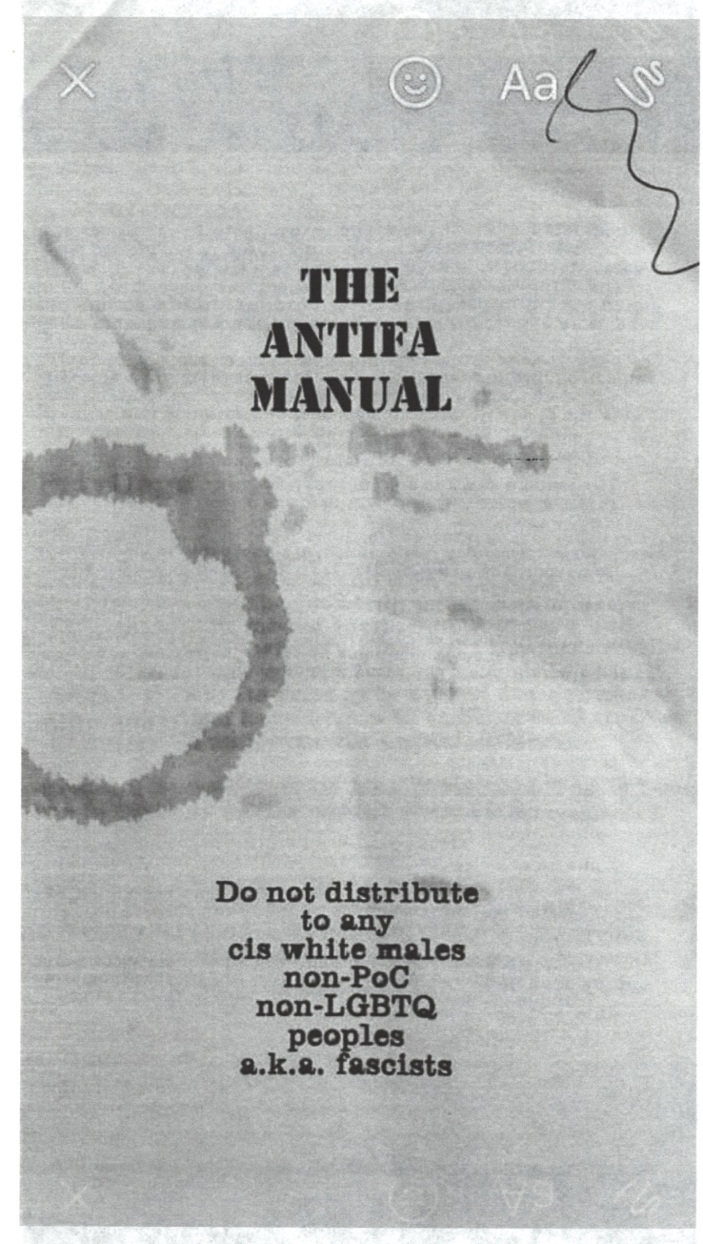
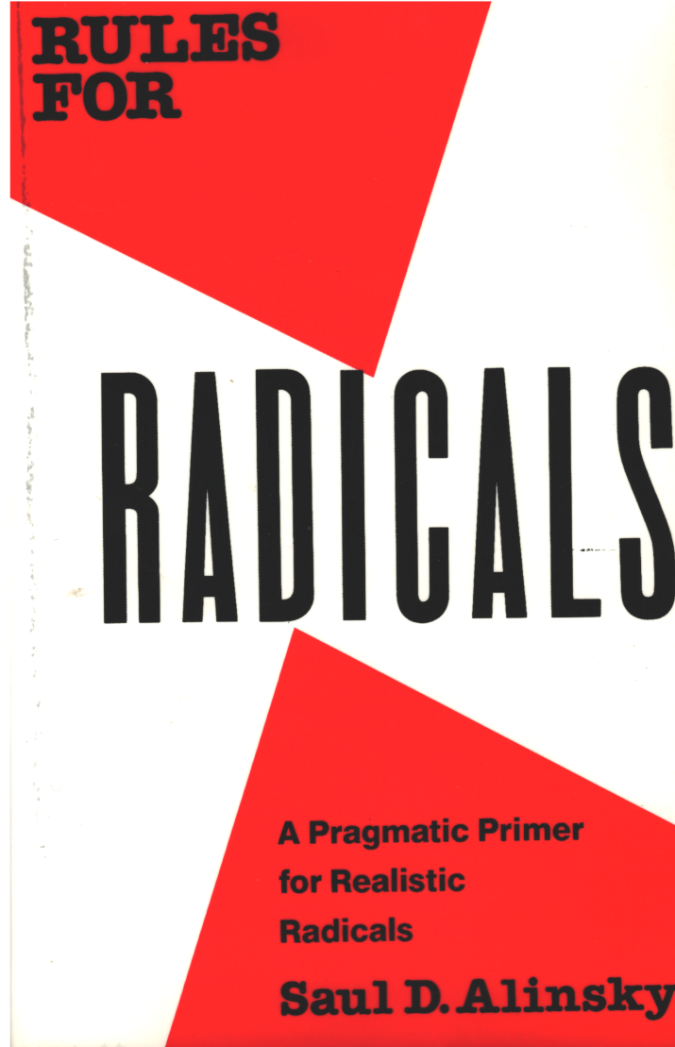
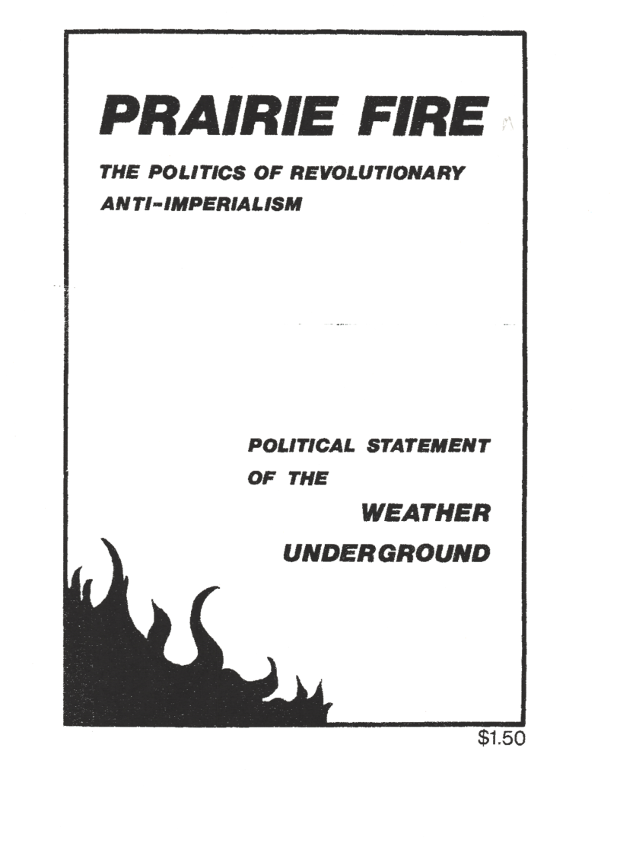
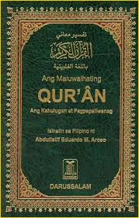

Slide 4
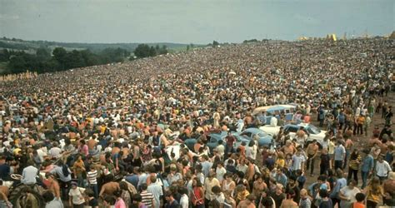
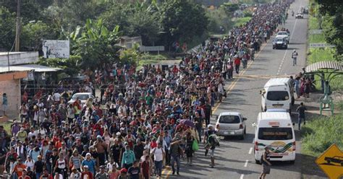
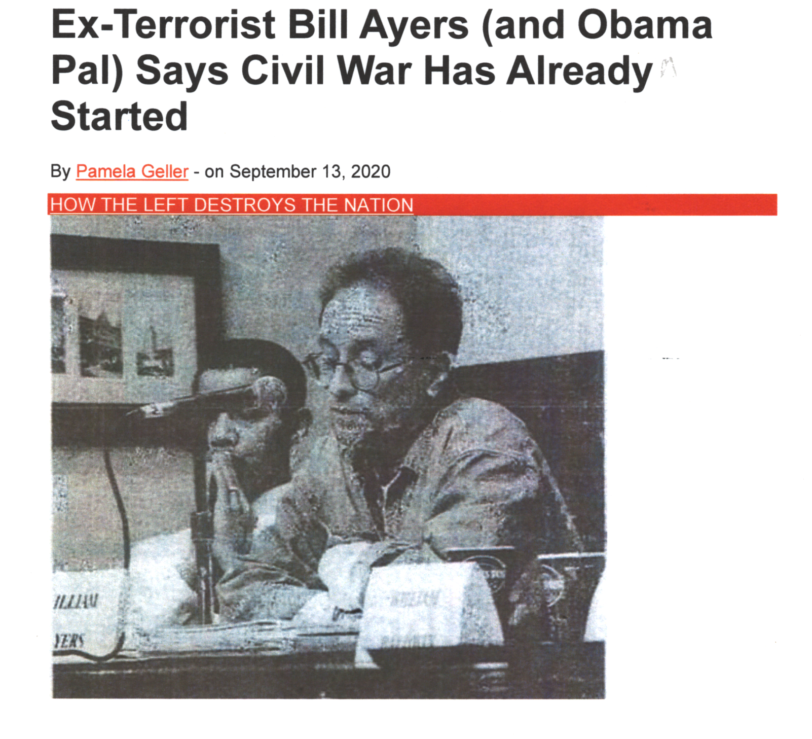
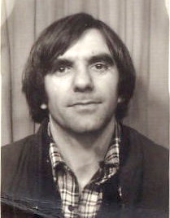
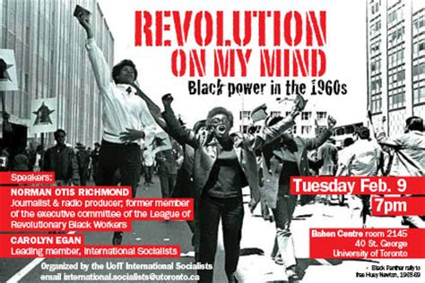
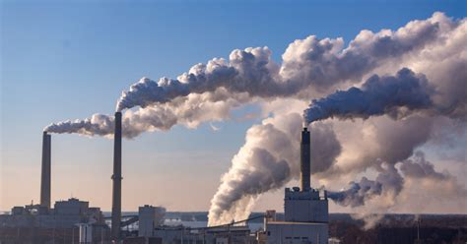
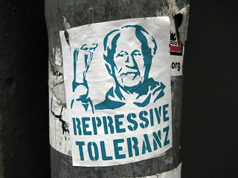
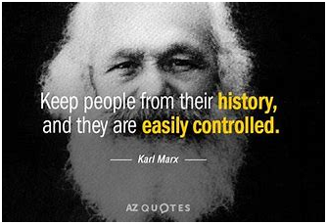
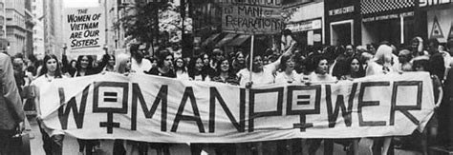
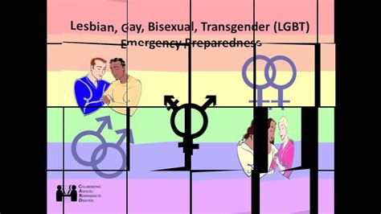
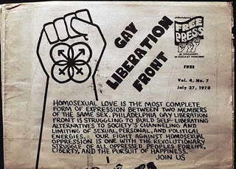
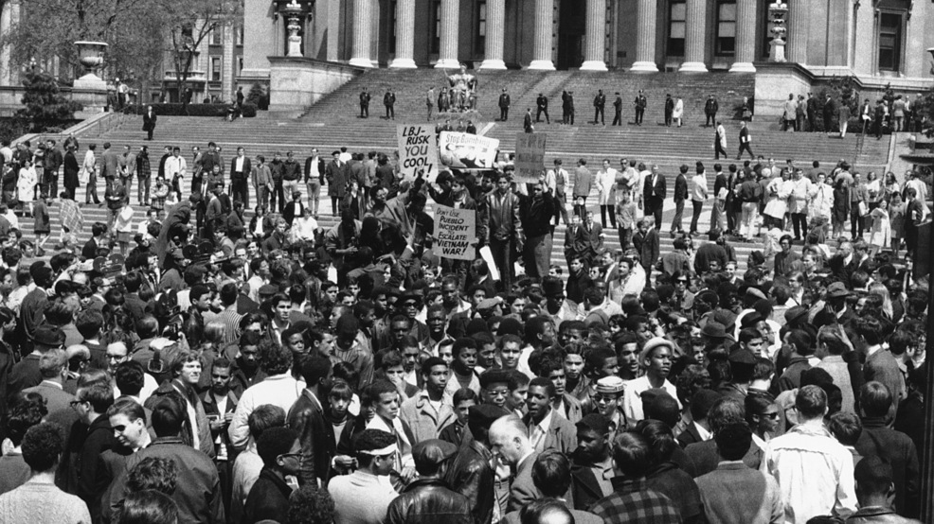
Rudi Dutschke
Herbert Marcuse
INSURGENCY

Slide 5
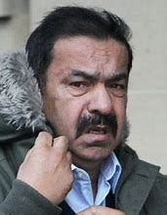
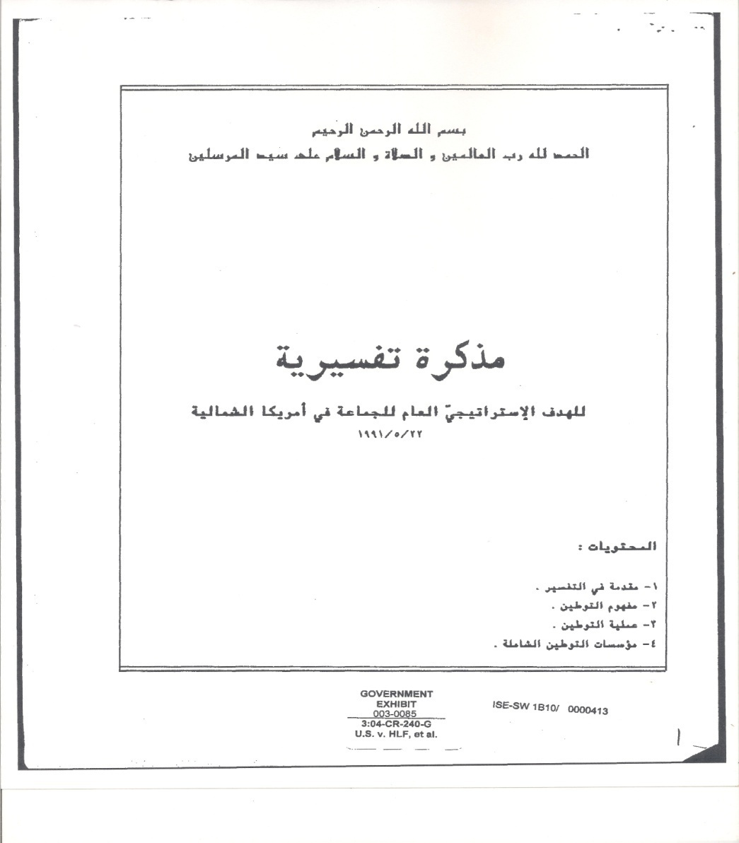
Mohamed Akram Adlouni
“The Ikhwan must understand that their work in America is a Grand Jihad in destroying Western civilization from within and sabotaging its miserable house by their own hands AND the hands of believers
“So that America is eliminated and god’s religion is made victorious
“Without this level of understanding we are not up to the challenge & not prepared for jihad…” Author: Mohamed Akram

Slide 6
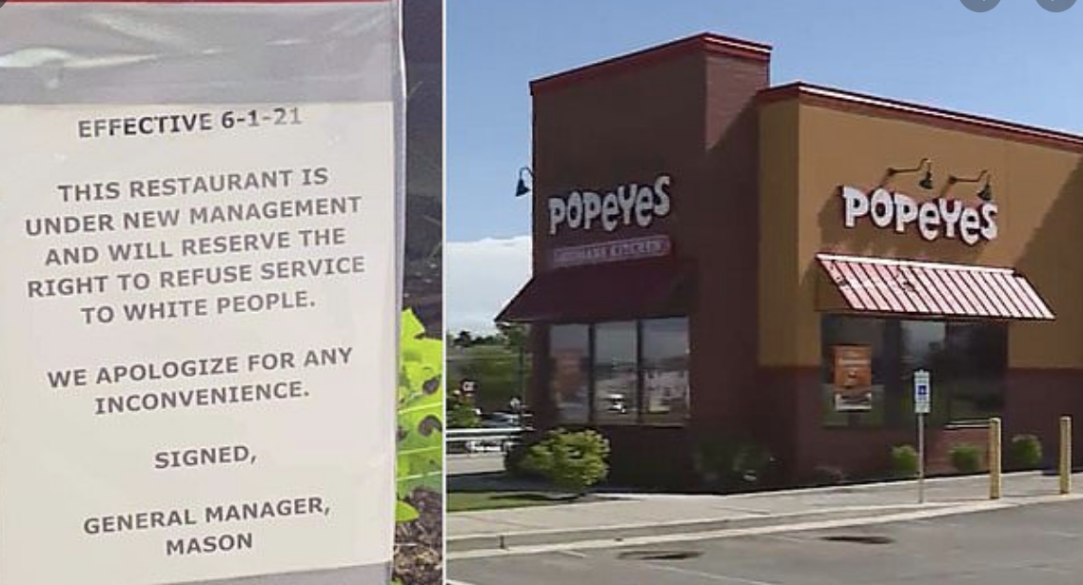
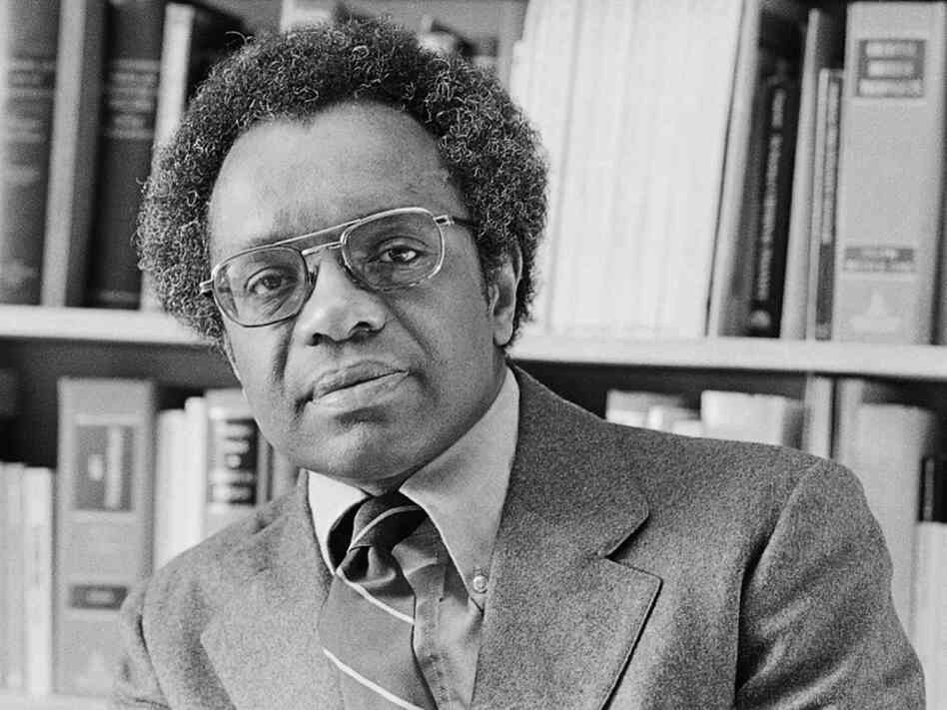
Derrick Bell

Slide 7
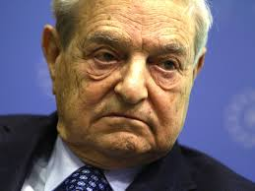
More MB Sponsored Social Unrest to Come?
Prime Mover: George Soros
Supports Ties with Muslim Brotherhood
Funds 187 Organizations Attacking Trump
Pays Protesters $10 to $15 Per Hour

Slide 8
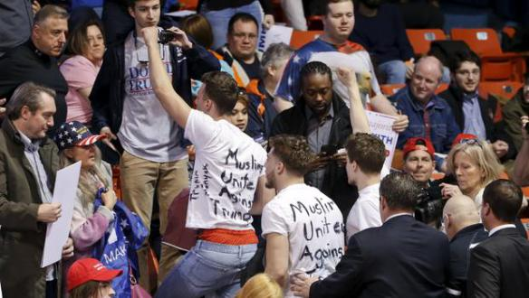
Chicago Protests Against Trump
Chicago University MSA Organized Protests
Supported by MoveOn.org & Funded by CAIR
End Vetting Muslim Immigrants
No Suspension of Muslim Refugees
No Mosque Monitoring
Mobilized Black, Latino, & Muslim Students
Used Craigslist to Solicit Demonstrators
Joined Forces with “Black Lives Matter”

Slide 9
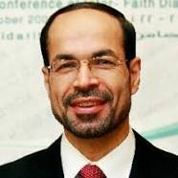
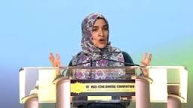
BLM Link to Islam
CAIR Dir. Nihad Awad: “BLM is our matter. BLM is our campaign”
Khalilah Sabra: “You (BLM members) are the new black people in America. If you don’t stand, you will see Muslims murdered in the street”

Slide 10
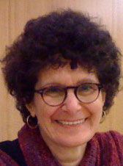
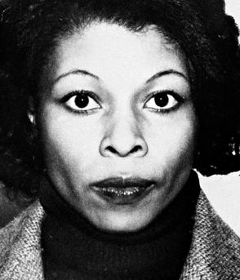
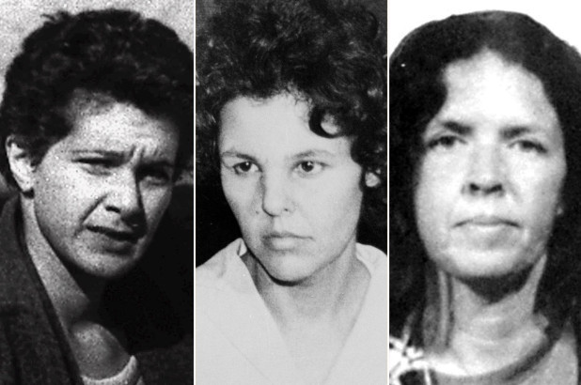
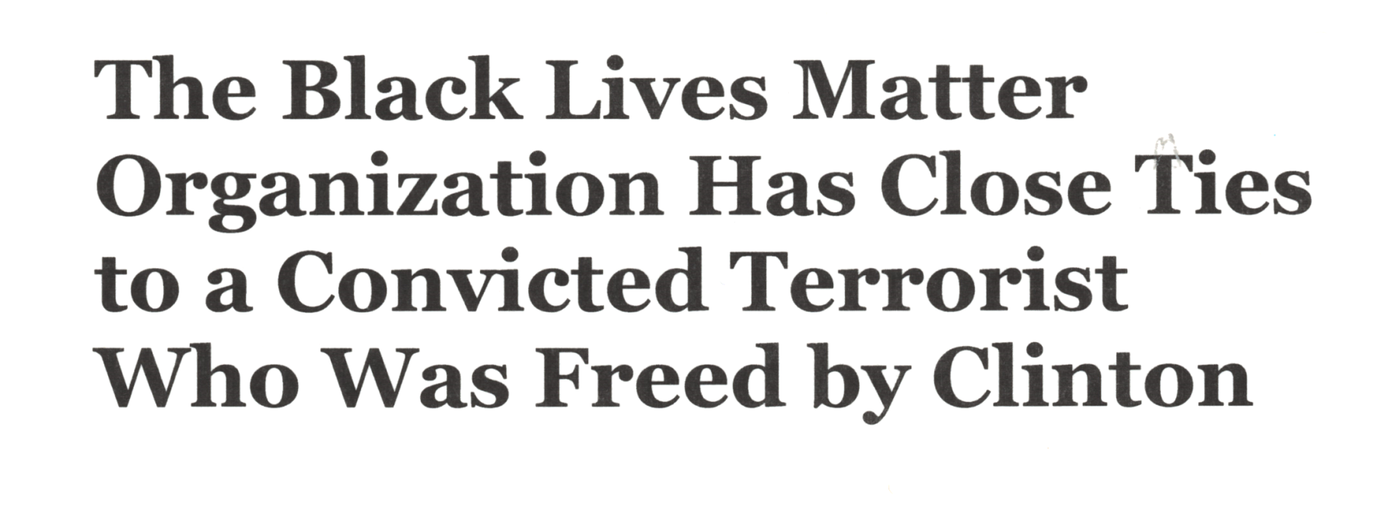
Black Lives Matter
Patrise Cullors
Opal Tometi
Alicia Garza
Susan Rosenberg
Assata Shakur AKA Joanne Chesimard

Slide 11
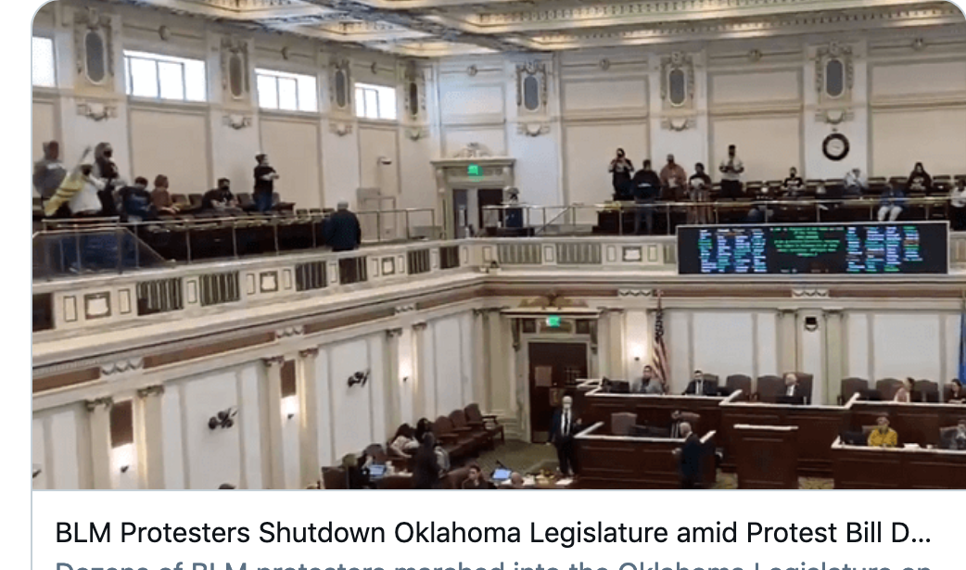
BLM Agenda
Abolish Traditional Nuclear Family
Dismantle LE & Prisons
Legitimize Transgenderism
Abolish Capitalism

Slide 12
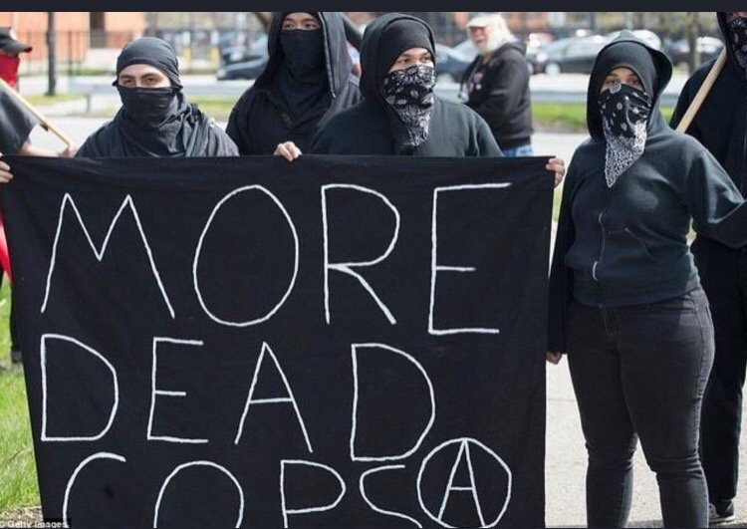
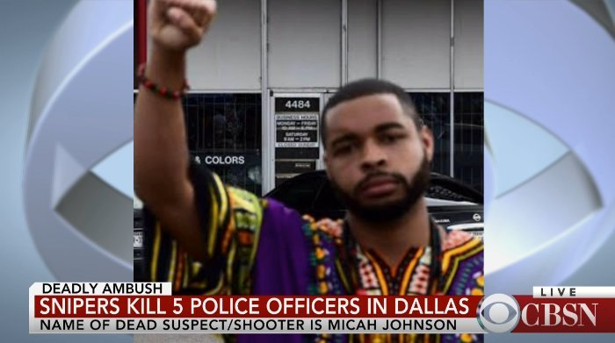

Slide 14
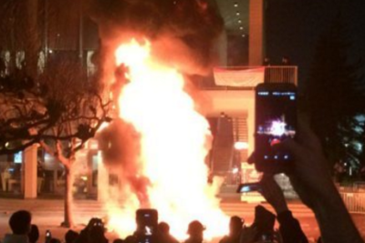
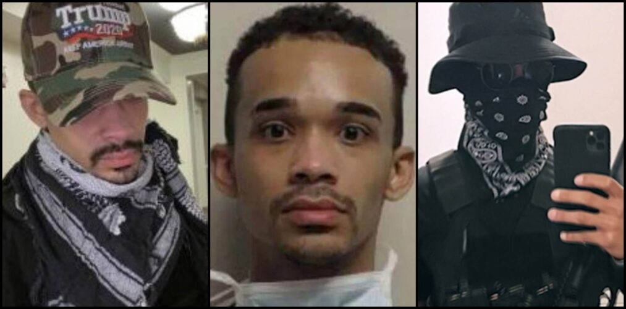
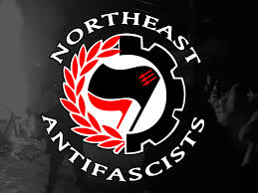
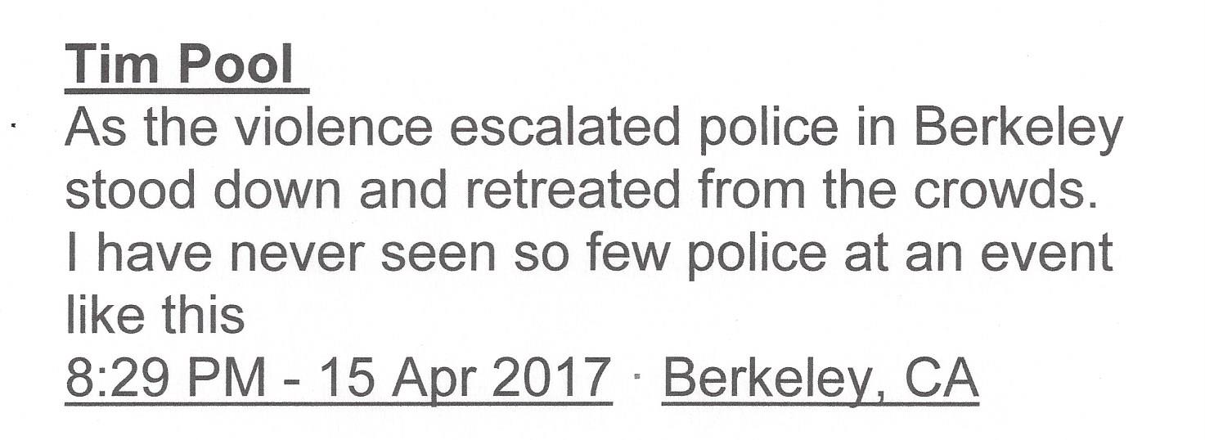
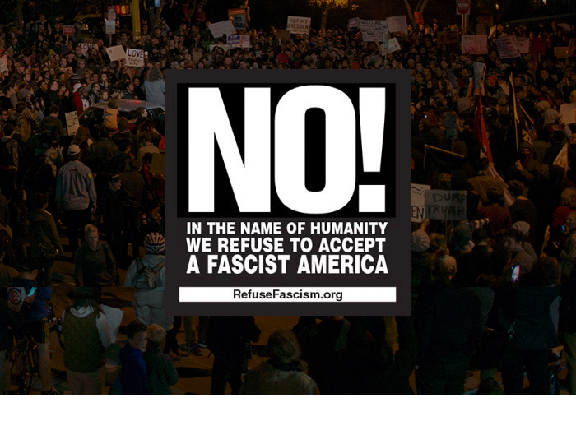
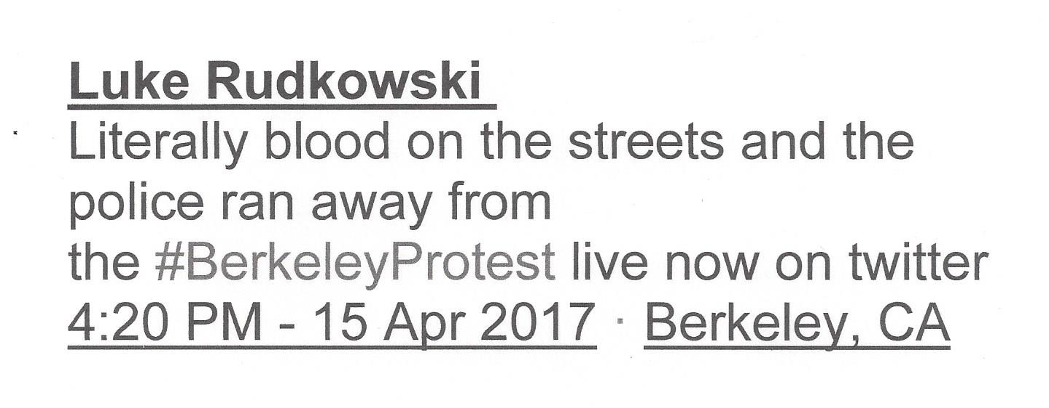

Slide 15
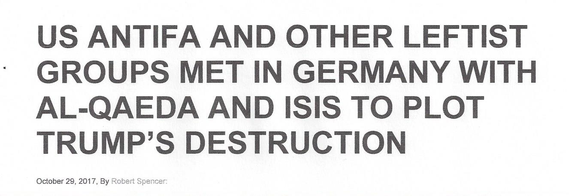

Slide 16
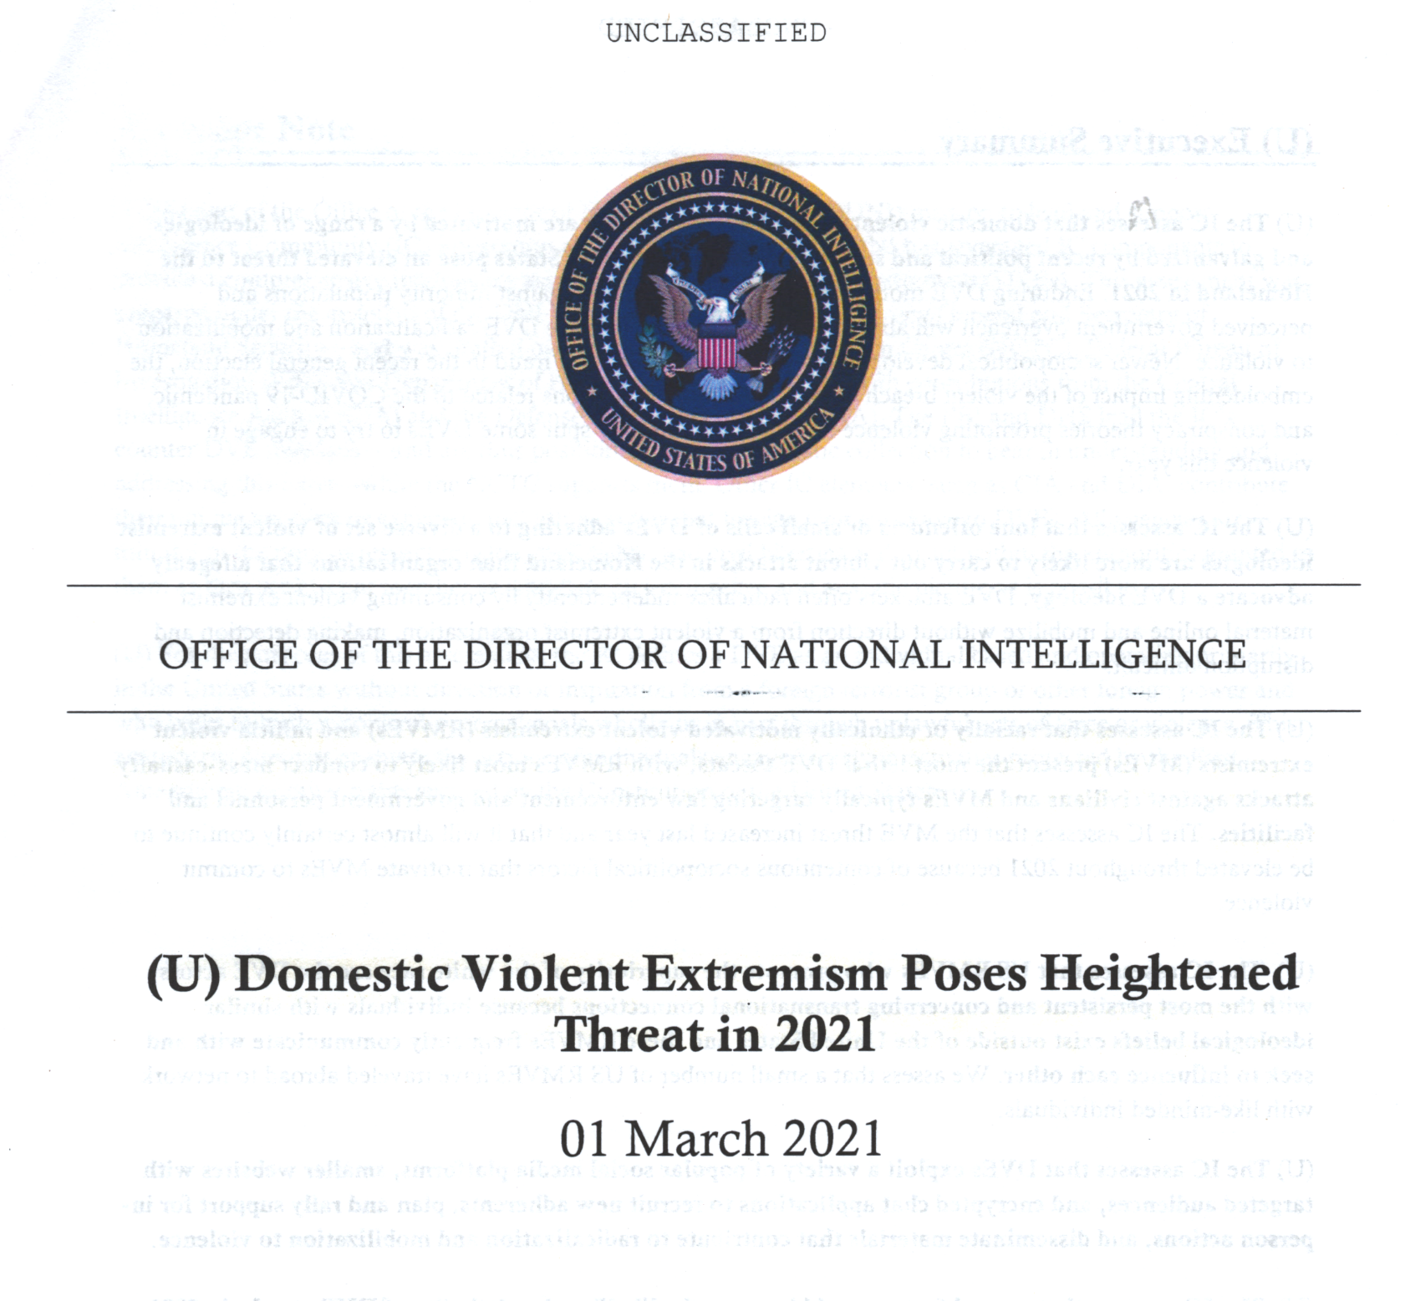
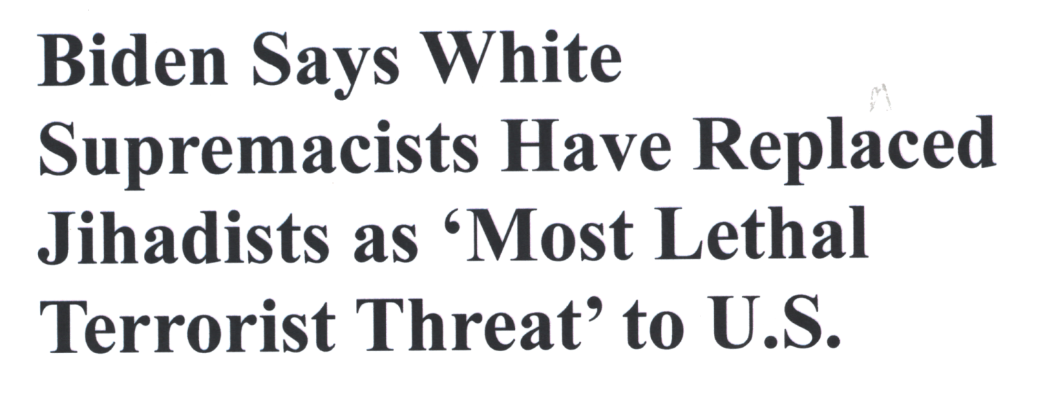
“The IC assesses that racially
or ethnically motivated violent
extremists (RMVE’s) or
militia violent extremists (MVE’s)
present the most lethal DVE threats…”

Slide 17
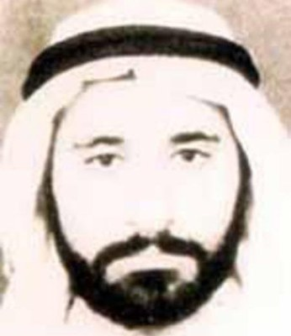
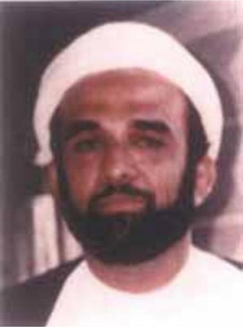
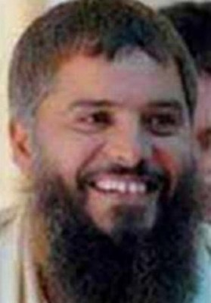
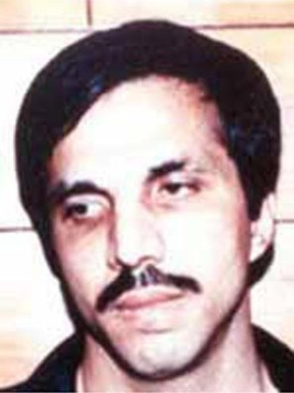
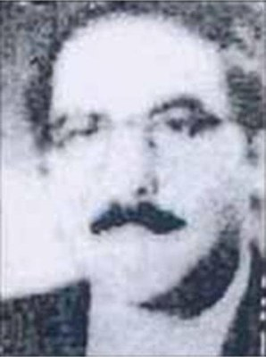
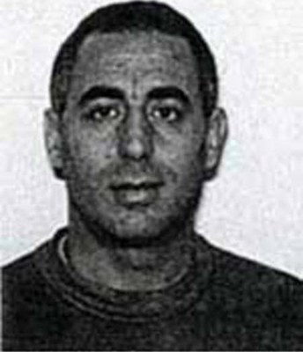
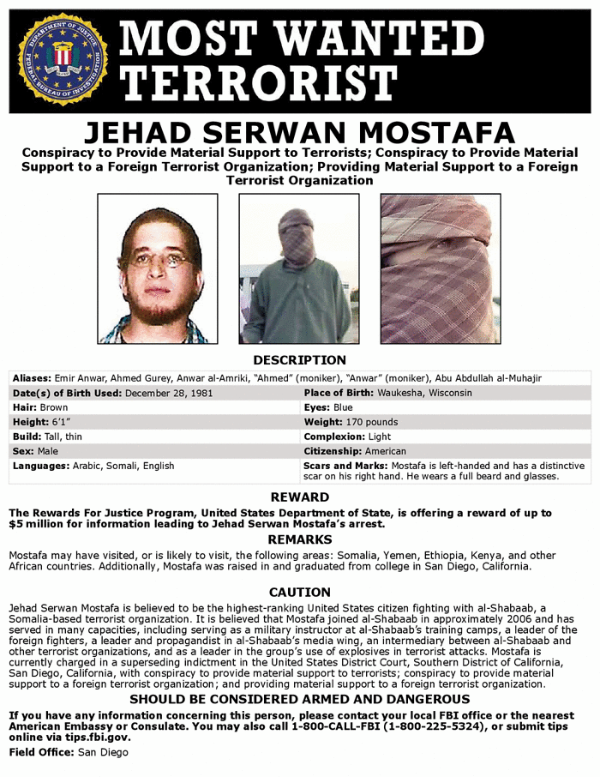
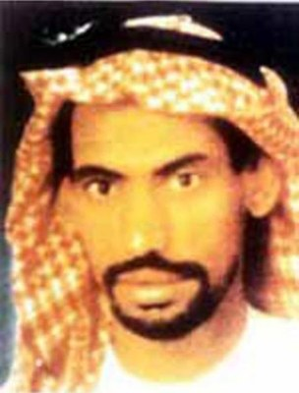
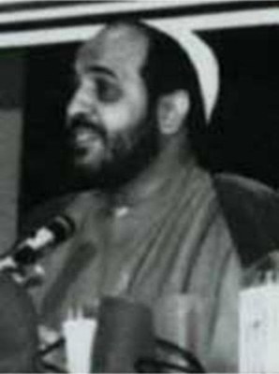

Slide 19
Robert Aaron Long
As of April 1, 105 charged
mass shooters in 2021

Slide 20
The Social Unrest Link to Red/Green Axis
ISIS & MB Groups Influenced Ferguson, Baltimore, & Many Other Urban Protests and Riots;
George Soros is Major Funder of Groups Promoting Social Unrest & Linked to MB;
MSA & CAIR Behind Anti-Trump Protests;
MB Allied with BLM;
Antifa Linked to ISIS & al-Qaeda;
Antifa, BLM & Jihadist Movements Promote Violence;
Democratic Party Following Weather Underground Play Book in Promoting Marxist/ Socialist/MB Insurgency

Slide 21
“Only a coalition of Marxists
and Islamists can destroy the
United States”
Ilich Ramirez
AKA: Carlos the Jakel

Slide 22
And What Are Our Elected Officials & Candidates Saying About This?
Their Silence is Deafening!

Slide 23
ACTION: STAY INFORMED
Frontpagemag.com
Jihadwatch.org
Barenakedislam.com
Gatestoneinstitute.org
Gellerreport.com
Discoverthenetworks.org
TheUnitedWest.org
Leoholmann.com

Slide 24
Affiliate of :
Contact Info: spearpoint911@shariacrimestoppers.org
Website: https://www.theunitedwest.org/sharia-crime-stoppers/
Facebook: https://www.facebook.com/ShariaCrimeStoppers/

